Slide 1

Project Title - Seasonal Agriculture Performance Analysis - A Data-Driven Approach
Kushal. B. Panchal
K J Somaiya Institute Of Technology
AICTE STU ID : STU6a43f00388ac21782837251

Slide 2

PROBLEM STATEMENT
Agricultural activities are influenced by seasonal variations in environmental conditions, farming practices, resource availability and market conditions. As a result, agricultural performance may differ from one season to another. However, raw agricultural data does not clearly explain how agricultural performance changes across seasons or what patterns can be observed in different seasonal conditions. The problem is to analyze the given agricultural dataset and investigate seasonal differences in agricultural performance by identifying meaningful patterns, trends, relationships and variations within the available data.

Slide 3
Project Description
This project focuses on analysing seasonal agricultural performance data using data analysis and visualization techniques. The dataset contains information such as farm location (state, district), crop type, season, farm area, rainfall, temperature, humidity, soil properties, fertilizer and pesticide usage, seed quality, yield, production, market price, cost, revenue, profit, water usage, and disease/pest risk. The analysis explores relationships between these variables and examines how agricultural productivity and profitability vary across different seasons. Techniques such as data cleaning, descriptive statistics, distribution analysis, correlation heatmaps, box plots, and scatter plots were applied to investigate crop-specific performance, environmental influences, resource efficiency, and seasonal outcomes. The project helps stakeholders understand seasonal patterns, identify key factors influencing yield and profit, and derive insights for better crop planning, resource management, and policy support.

Slide 4

WHO ARE THE END USERS?
Farmers & Communities → Understand seasonal yield/resource variations; plan practices effectively.
Planners & Policymakers → Design evidence-based strategies; support sustainable agriculture.
Researchers & Analysts → Explore datasets; identify seasonal trends and relationships.
Agri-Business & Supply Chain → Anticipate production changes; optimize resources and market planning.
Students & Educators → Gain hands-on analytics experience; apply statistical/visualization techniques in agriculture.

Slide 5

Technology Used
Python → Core programming language for analysis.
Pandas → Data loading, cleaning, and manipulation.
NumPy → Numerical computations and statistical measures.
Matplotlib → Basic plotting and visualizations.
Seaborn → Advanced statistical plots (countplots, boxplots, heatmaps, scatter plots).
Google Colab → Interactive environment for coding, visualization, and documentation.
Data Visualization Techniques → count plots, Histograms, box plots, scatter plots, heatmaps for insights.
Statistical Analysis → Descriptive statistics, correlation analysis, and trend identification.

Slide 6
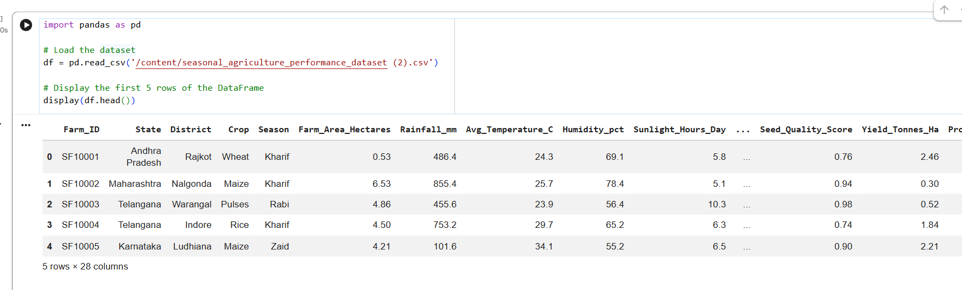
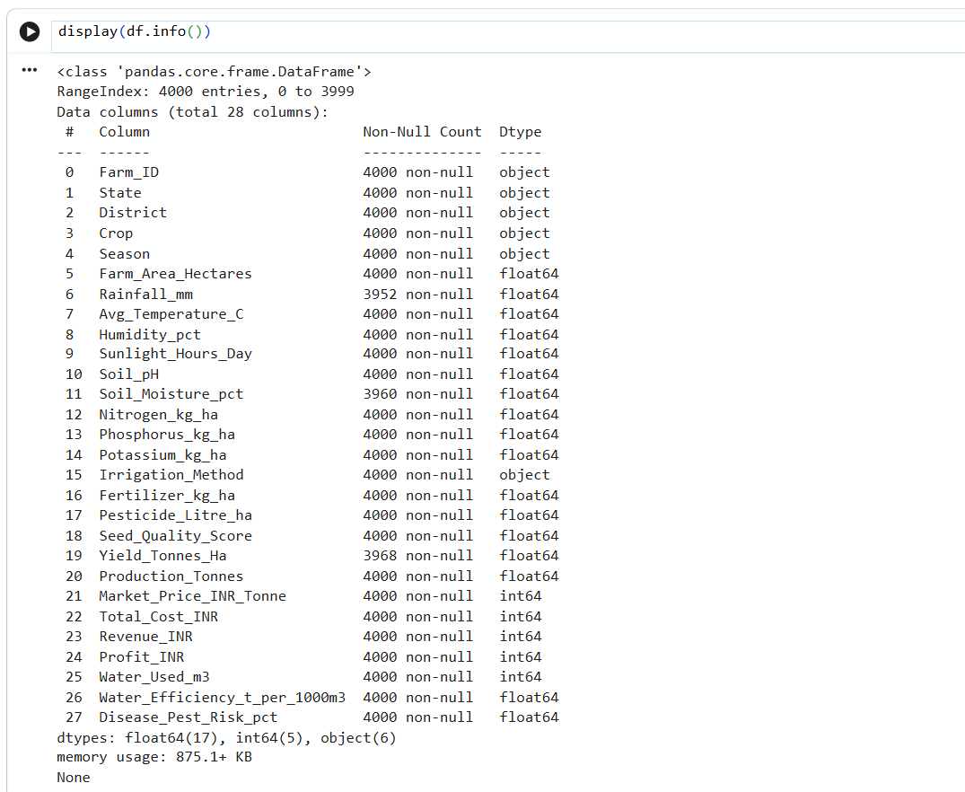
RESULTS

Slide 7
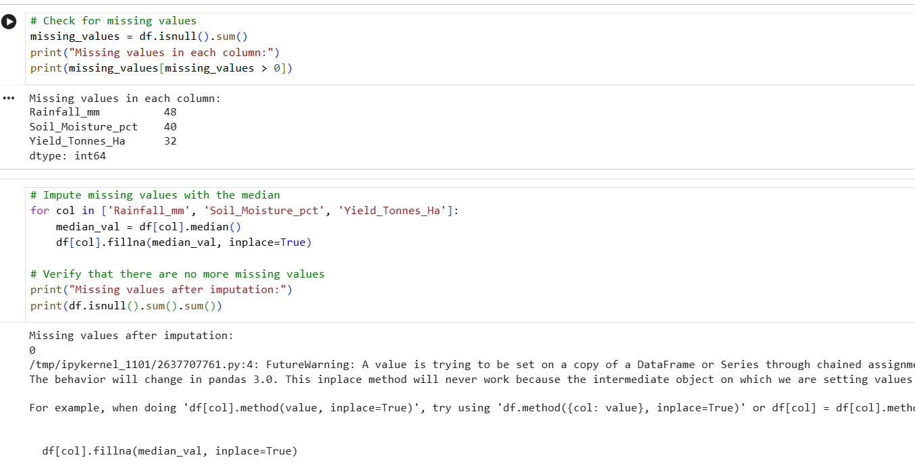
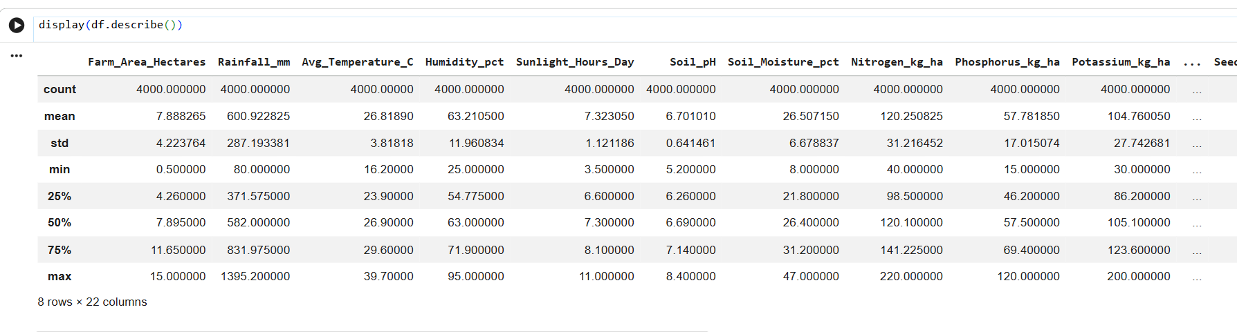
RESULTS

Slide 8
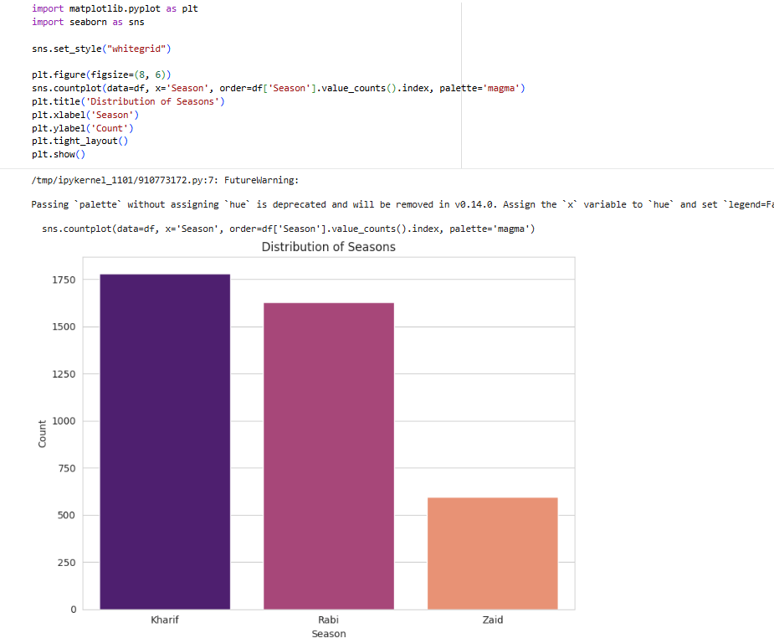
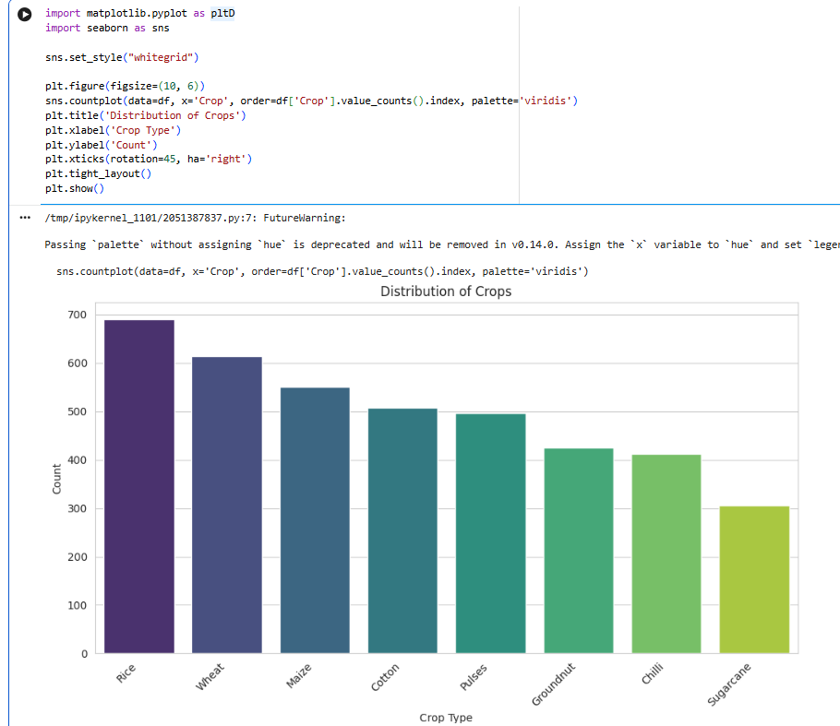
RESULTS

Slide 9
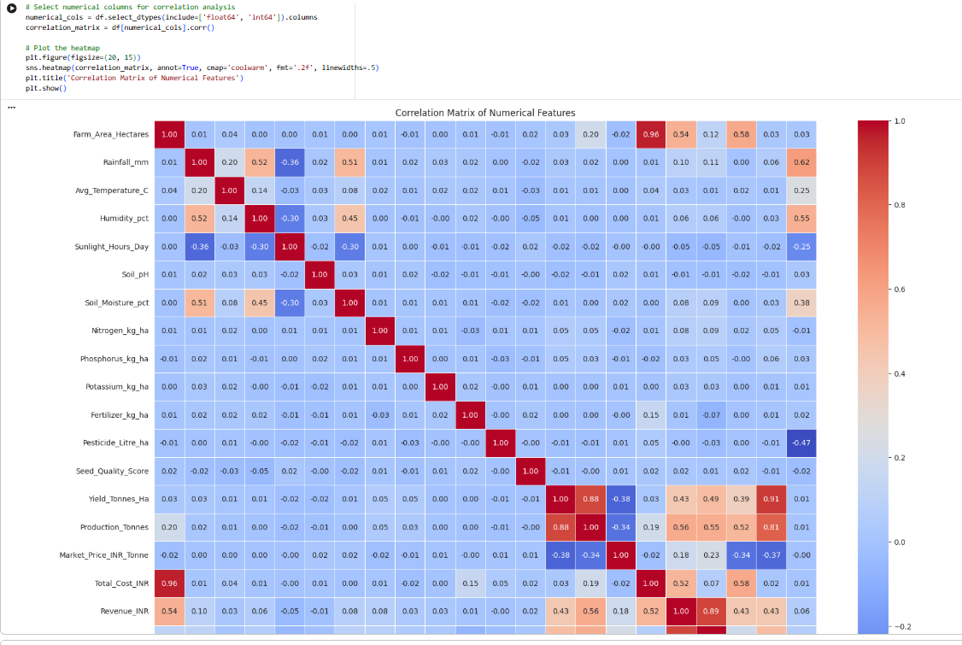
RESULTS

Slide 10
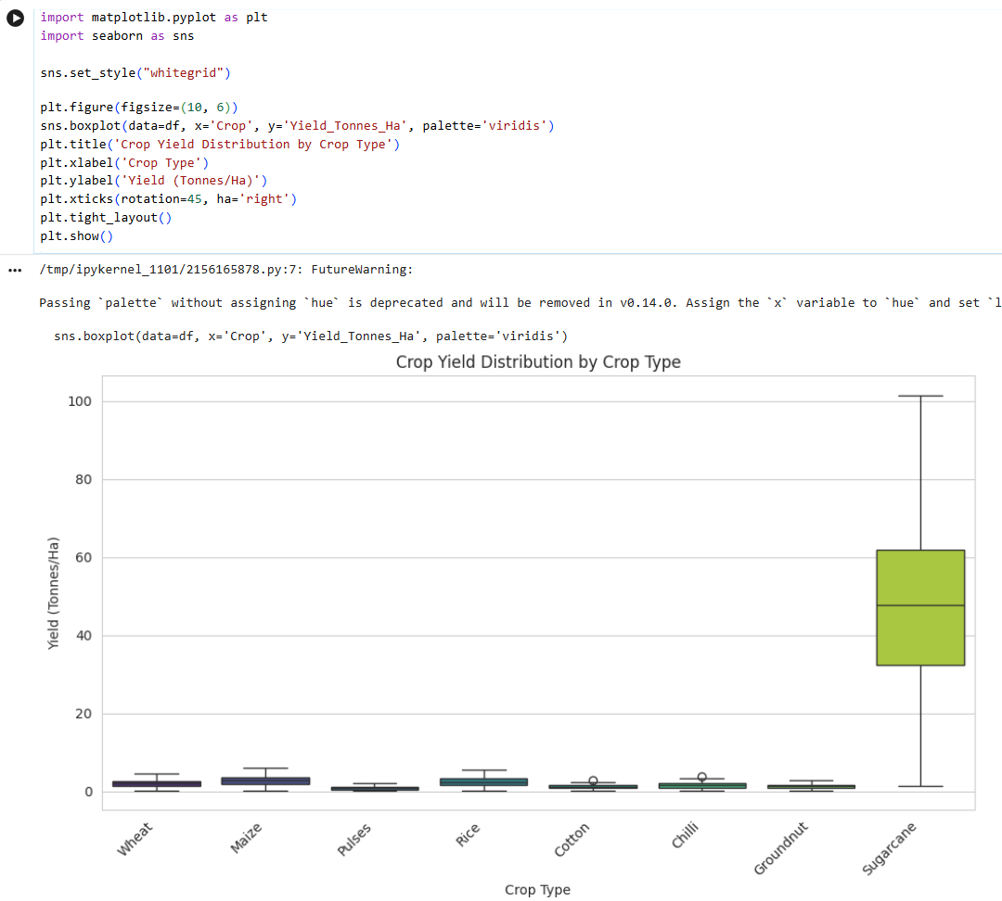
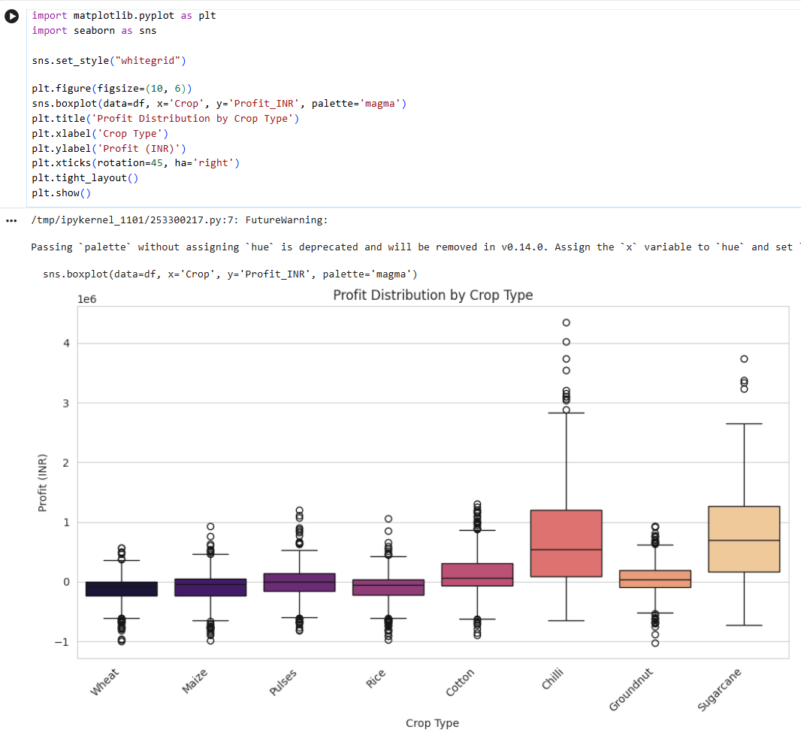
RESULTS

Slide 11
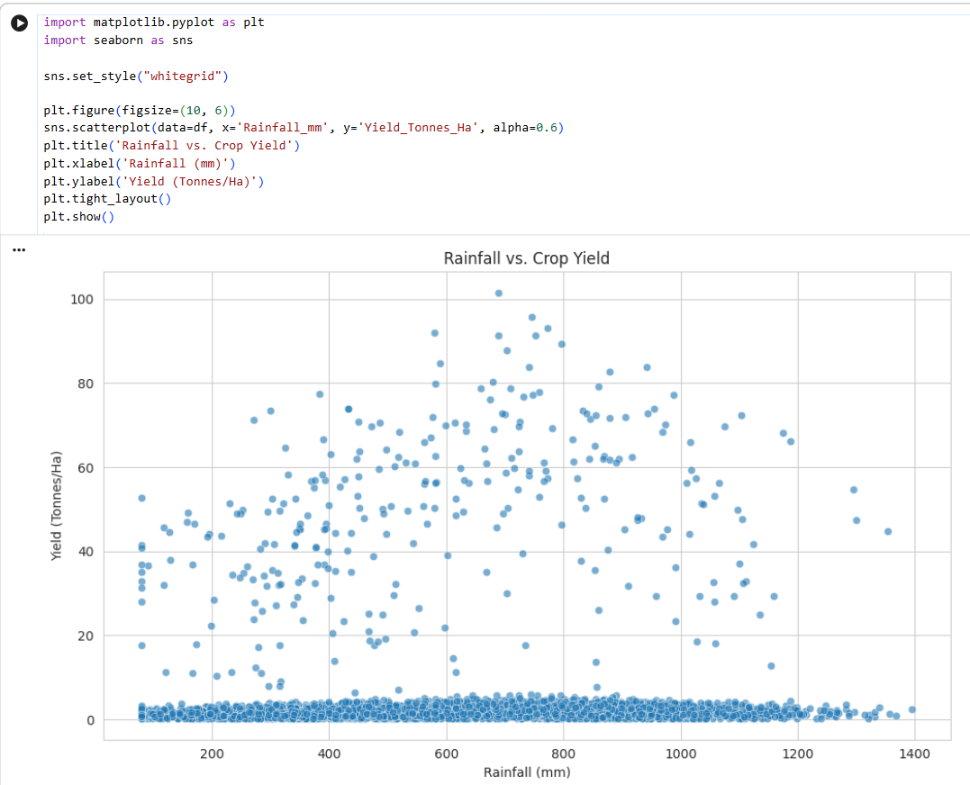
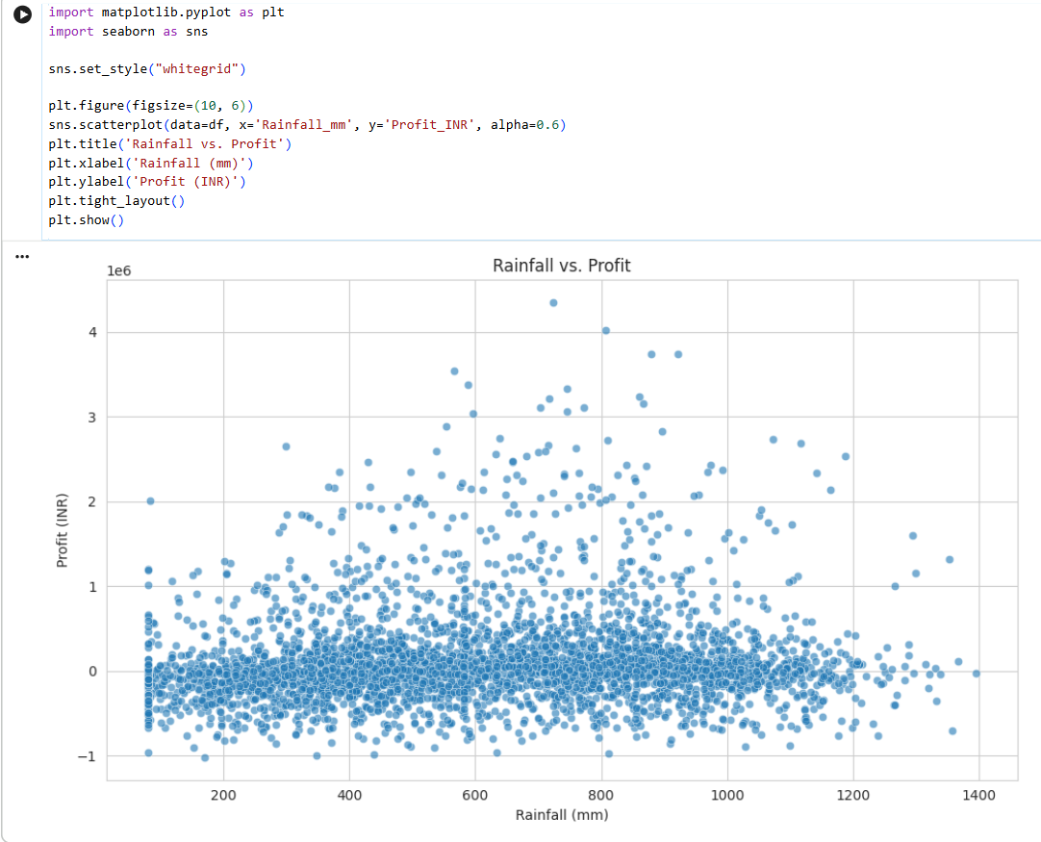
RESULTS

Slide 12
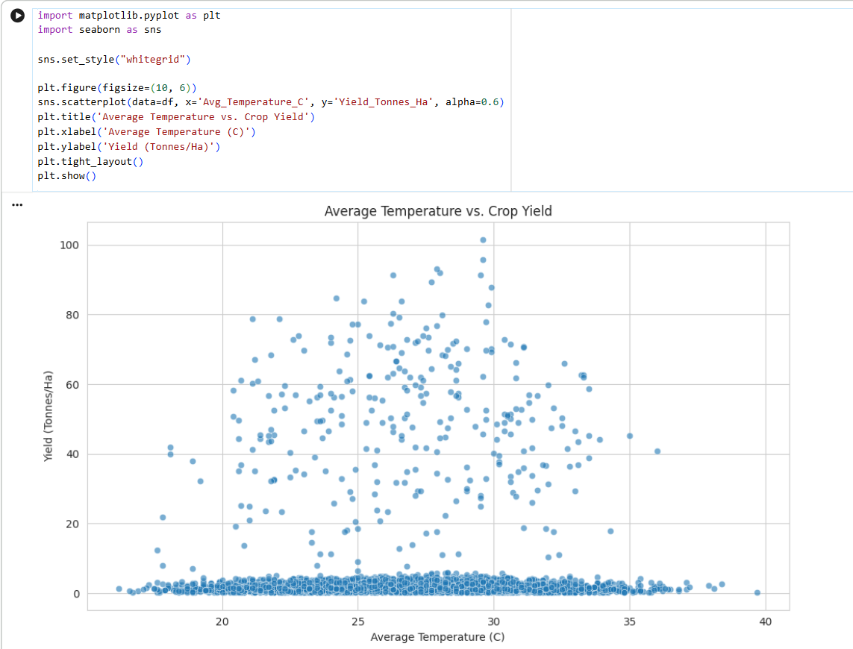
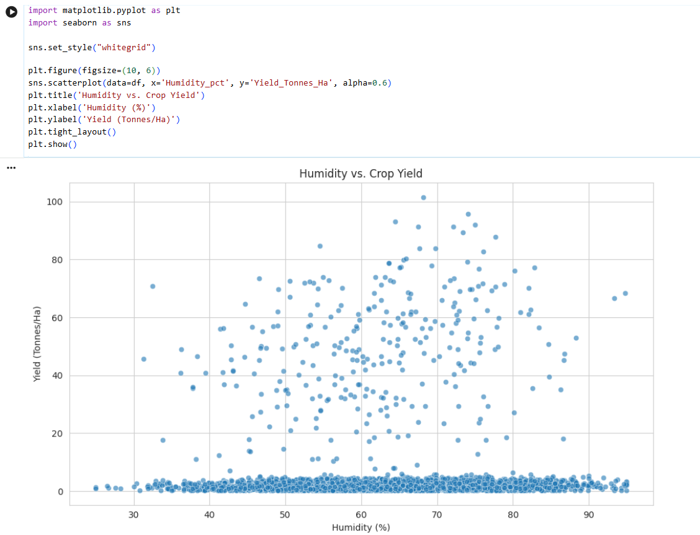
RESULTS

Slide 13
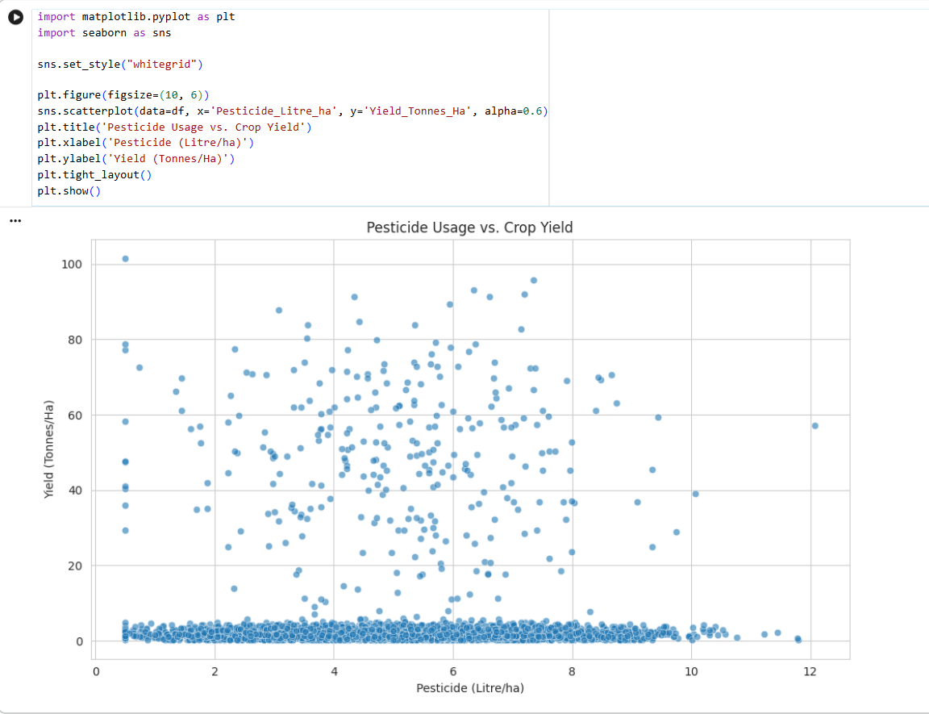
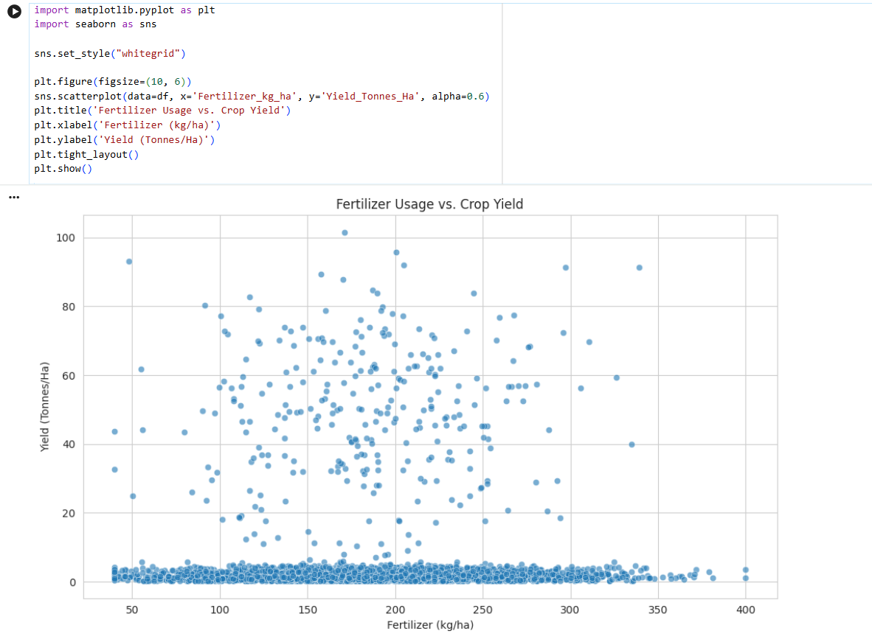
RESULTS

Slide 14
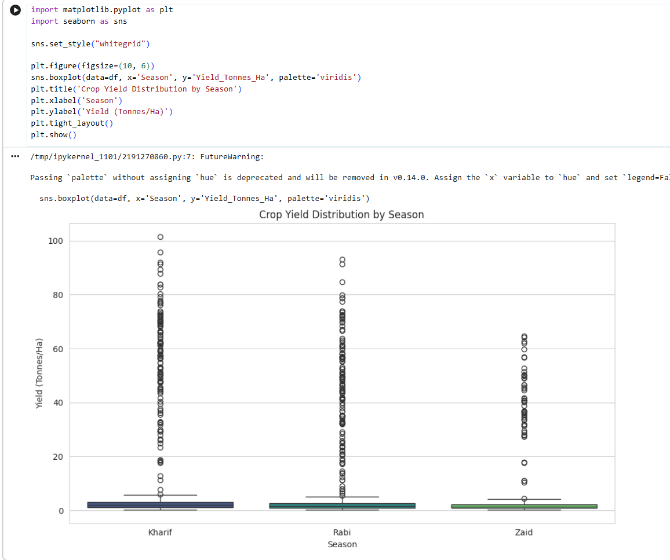
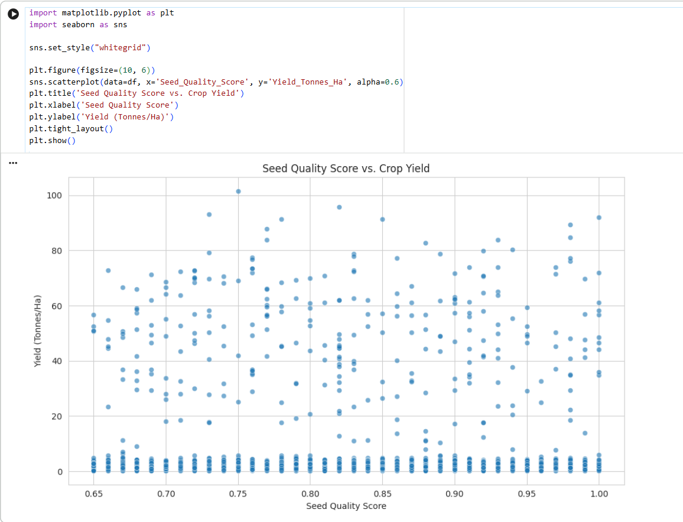
RESULTS

Slide 15
Future scope
Segmentation Analysis - Deeper insights by analyzing season × crop × region combinations.
Predictive Modeling - Use machine learning to forecast yields, profits, and resource needs.
Optimization Studies - Explore best crop-resource combinations for sustainable profitability.
Policy Applications - Provide data-driven recommendations for government support programs.
Scalability - Extend analysis to larger datasets across multiple states and years.
Integration - Combine with satellite/weather data for real-time agricultural decision-making.

Slide 16
GitHub Link

Slide 17

VOIS Course completion certificate -
Course name- Data Visualization

Slide 18
Thank you
.
.

